Slide 1
Useful and Wasted Energy

Slide 2
By the end of this lesson, you should be able to do the following:
Describe useful energy.
Describe wasted energy.
Calculate the energy efficiency of a common household appliance.

Slide 3


Slide 4

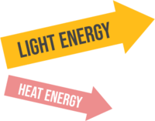

Lightbulbs convert electrical energy into light energy.
This is useful energy because it enables us to see in the dark.

Slide 5
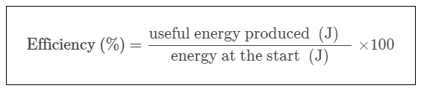

The efficiency of a transformation can be calculated with the following equation:

Slide 6


Did you know that car is only around 20% efficient?
This means that for every 100J of energy you put into the car to make it go, only about 20J is able to be used!
Using our energy efficiency equation, we get the following:

Slide 7

Lets work through an example.
What is the efficiency of a lightbulb if 50J of energy is put in but only 1J of light energy is produced?

Slide 8
